Slide 1
Now: A Spectral Approach to Ghost Detection
Next: On n-Dimensional Polytope Schemes and a special message from our sponsors

Slide 2
A Spectral Approach to
Ghost Detection
Daniel Maturana, David Fouhey
CHOCOLATE Lab, CMU RI

Slide 3
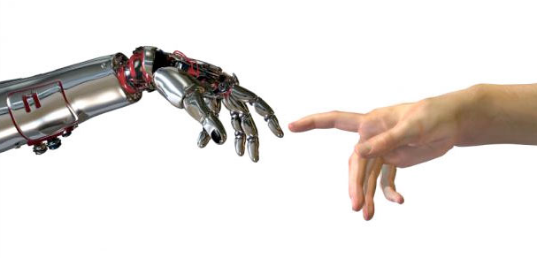
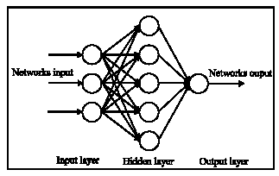
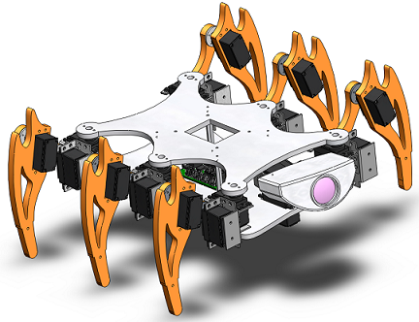
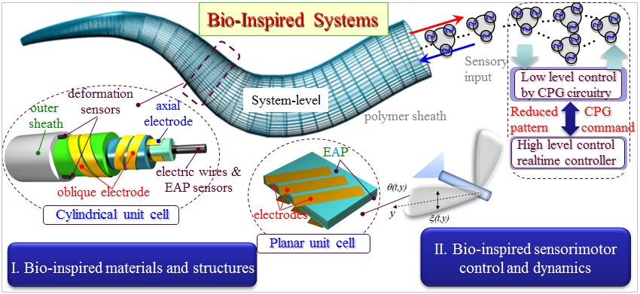
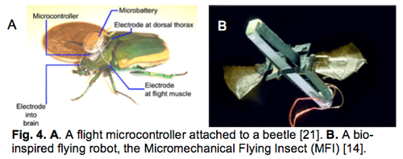
Motivation – Naturally Inspired Algorithms

Slide 4
Motivation – Naturally Inspired Algorithms
Falling down a slope [1951]
Climbing up a Hill [1970]
Iron Cooling Down [1970]
DNA Mutation [1989]
Meme Spreading [1989]
Ant colony exploration [1992]
Honeybee mating [2006]
Bee colonies [2005]
Glowworm communication [2009]
Firefly communication [208]
Musicians playing [2001]
Mosquito swarms [1995]
Honeybee swarms [2006]
Krill swarms [2009]
Cat swarms [200]
Magnetism [2008]
Intelligent waterdrops [2009]
River formation [2008]
Frog leaping [2008]
Monkey search [2007]
Bat echolocation [2010]

Slide 5
Zoo algorithm?
You got scooped!
(In submission)

Slide 6
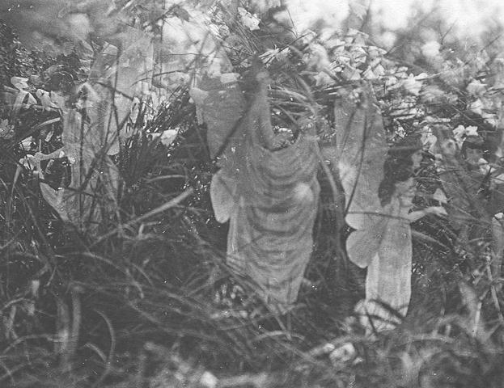
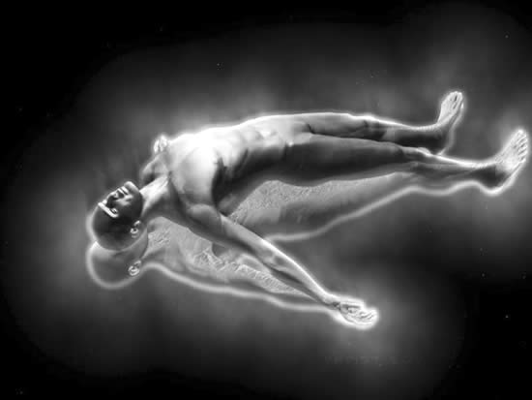
But what about the supernatural?

Slide 7
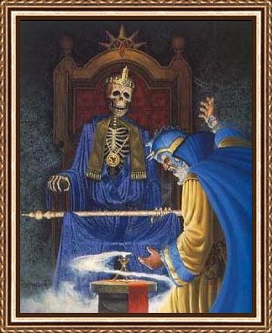
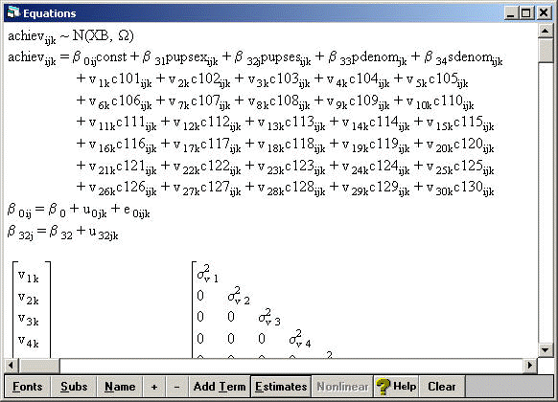
Related Work
Oracles (how do they know?)
Necromancy (kinda icky)
Multilevel Bayesian Modeling (really icky)

Slide 8
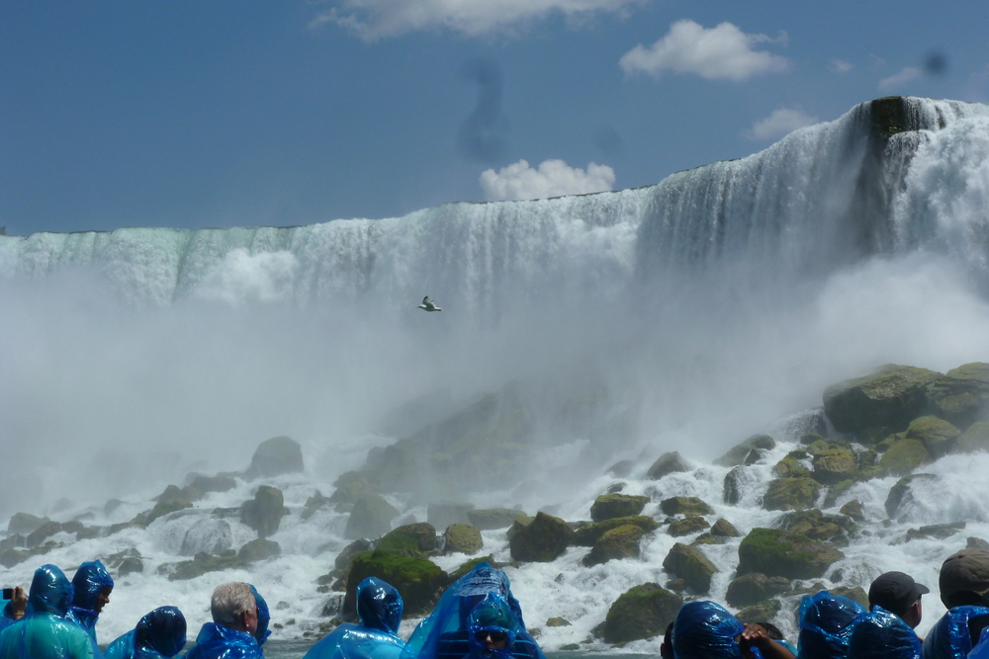
Application Domain
Cameras capture supernatural phenomena
Demons obviously!
From PI DF's Research Trip to Toronto and surrounding region

Slide 9
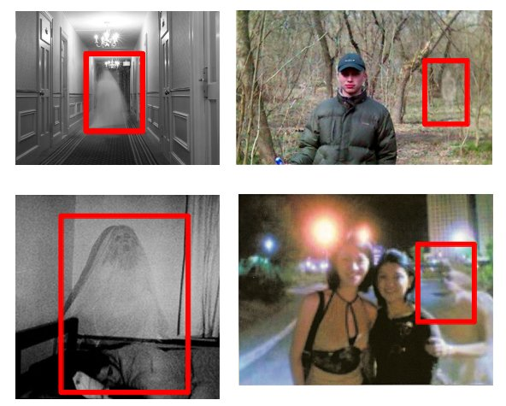
Application Domain
Ghosts ruin family photos
Detect with support vector machine (SVM) using spectral power features

Slide 10
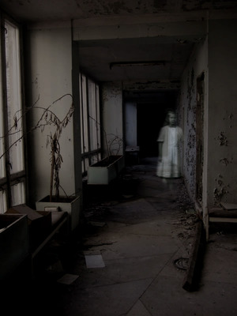
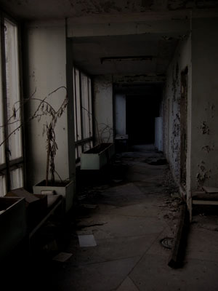
Ghost Removal
Developed a photoshop plugin
Before
After

Slide 11
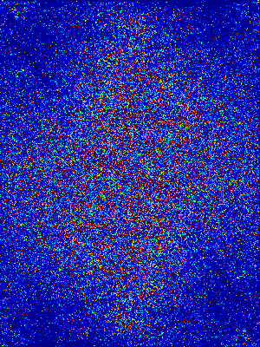
Ghost Removal Method
Input
Conclusive Proof of Ghosts
Fourier Transform
-
=

Slide 12
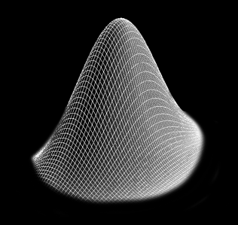
Toward Paranormal Statistics
Standard statistics (e.g., mixture of normal distributions) inadequate for dealing with demons, ghosts, etc.

Slide 13
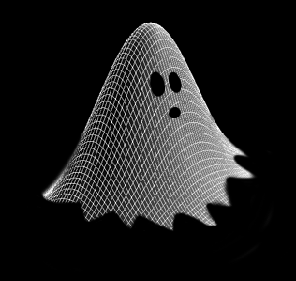
Toward Paranormal Statistics
Propose Paranormal distribution

Slide 14
Powerful Generalization
Mixture of Paranormals using Occult Variables

Slide 15
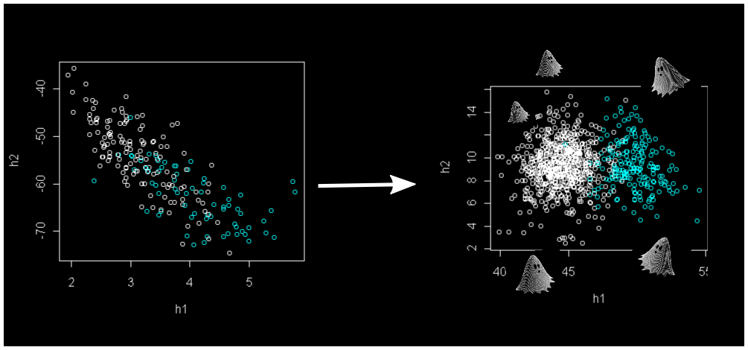
Fitting a paranormal distribution
Supernatural gradient descent
Astral projection for dimensionality reduction and unnaturally low condition numbers.

Slide 16
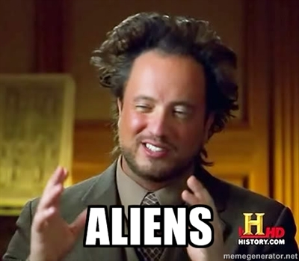
Last Resort?

Slide 17
Applications of
Paranormal Modeling

Slide 18
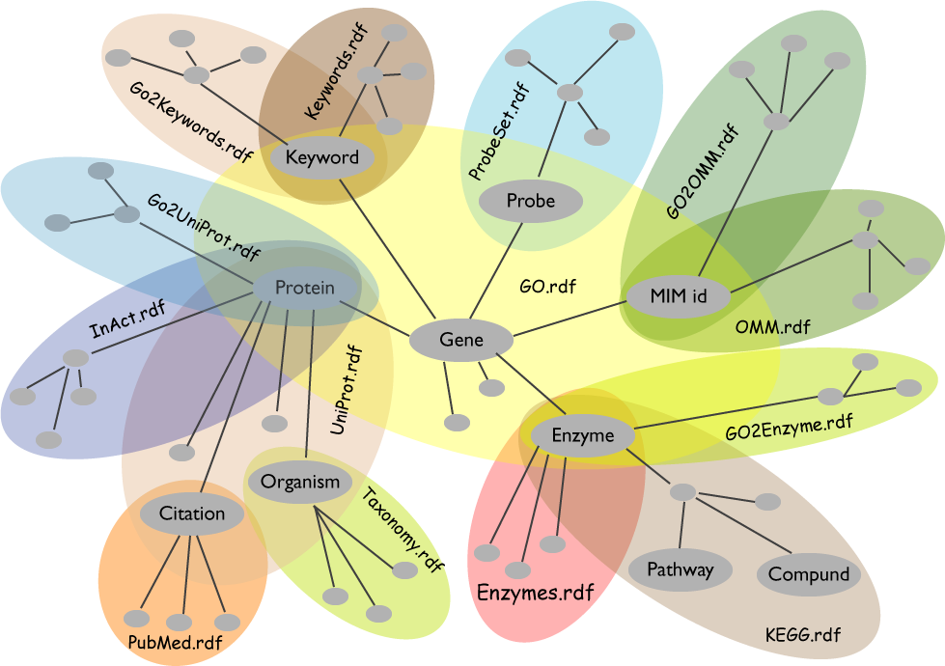
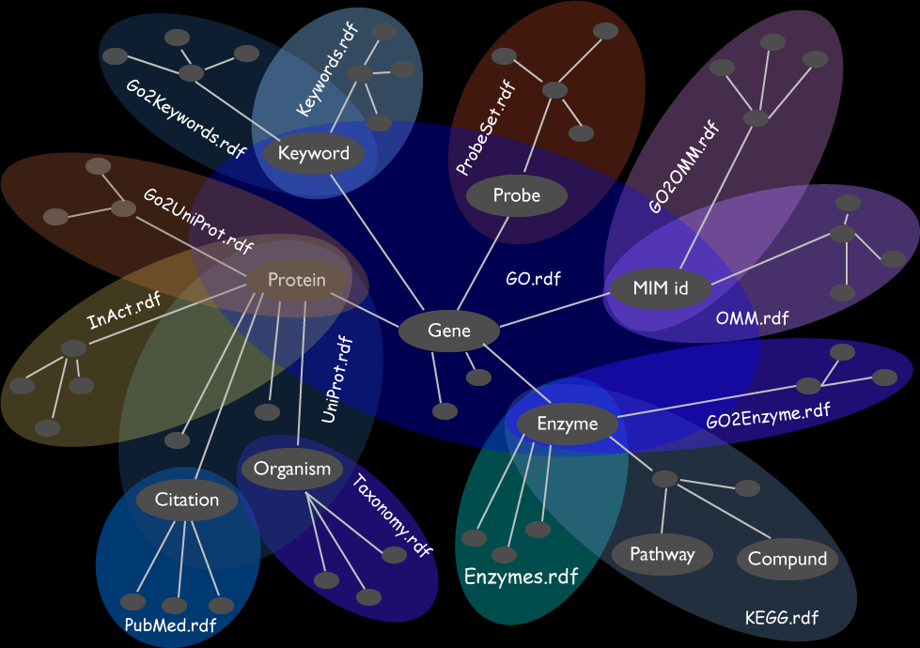
Hauntologies
Spookier = Guaranteed Novelty!

Slide 19
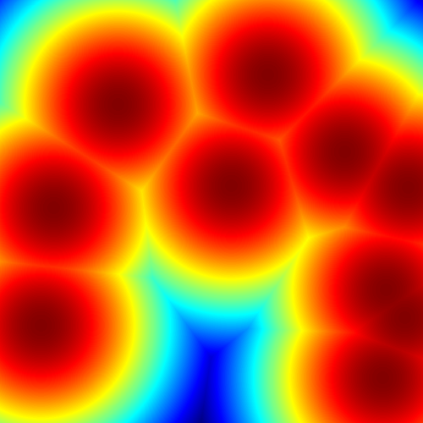
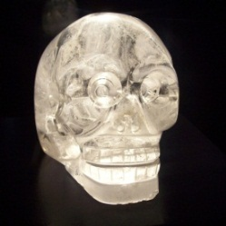
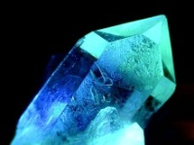
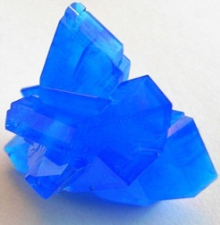
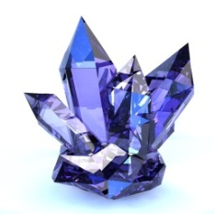
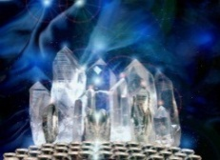
Crystal Energy Methods
Overcome local minima and heal the earth with crystal energy!

Slide 20
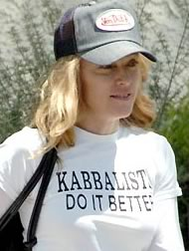
For K-Optimality, Kabbalah
See highly relevant work on K-optimality and celebrity-affiliated spaces in (Fouhey, Maturana SIGBOVIK '12).

Slide 21
Conclusion
Don’t let your work be constrained by reality!

Slide 22
Before: A Spectral Approach to Ghost Detection
Now: On n-Dimensional Polytope Schemes and a special message from our sponsors

Slide 23
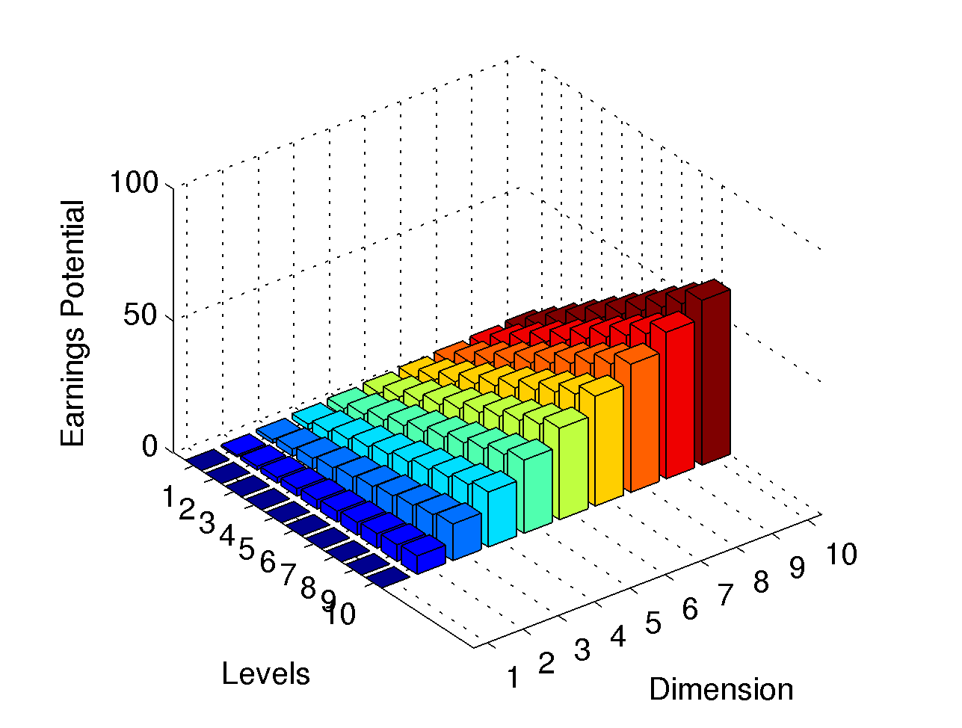
On n-Dimensional Polytope Schemes
David Fouhey, Daniel Maturana
CHOCOLATE Lab, CMU RI

Slide 24
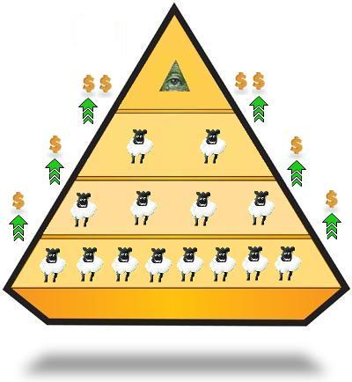
Before we begin
This is not a pyramid scheme.
This is not a pyramid scheme.
This is not a pyramid scheme.
This is not a pyramid scheme.
This is not a pyramid scheme.
This is not a pyramid scheme.
This is not a pyramid scheme.
This is not a pyramid scheme.

Slide 25
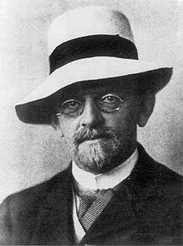
Review
Recall Hilbert's celebrated proof via elimination ideals that his creditors are owed no money [Hilbert 1895]
Leads to Hilbert's 24th problem:
Can one make money at home risk free with algebraic geometry?
Largest unsolved problem in algebraic geometry and set theory.

Slide 26
We answer positively
Yes, you can make money:
At home
At your own schedule
With no work
Risk free
With algebraic geometry!

Slide 27
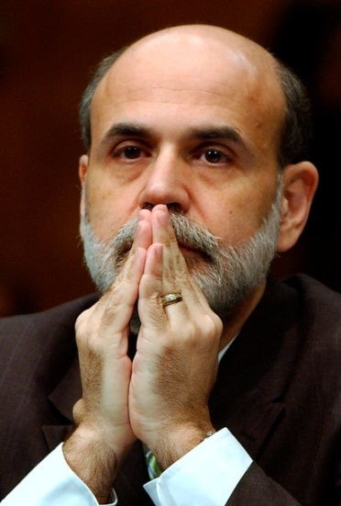
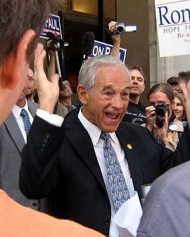
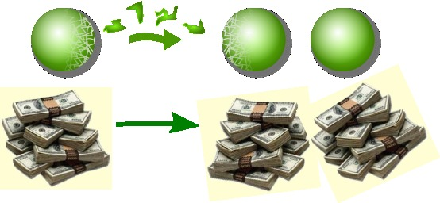
Proof?
Revolves around a secret analysis of n-Dimensional polytope schemes.
Inspired on Tarski-Banach paradox and Fiat currency
Valid for gold & silver standards

Slide 28
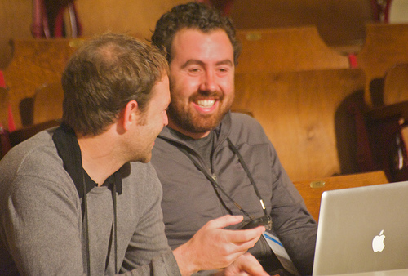
Watertight proof!
Watertight proof in our paper
Guaranteed income via Algebraic Geometry!

Slide 29
Too good to be true?
This is not a pyramid scheme.
$
$
p
p
Pyramid Scheme
Polytope Scheme

Slide 30
How to Join?

Slide 31
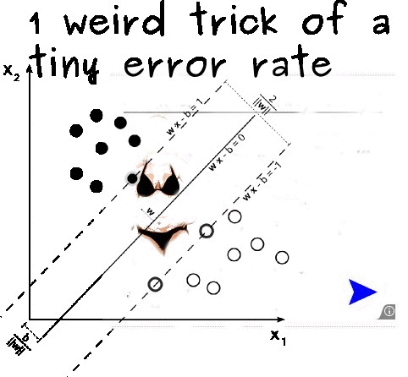

Slide 32
And now for a sponsored contribution
http://oneweirdkerneltrick.com/

Slide 33
Questions?

