Slide 1
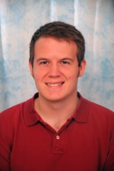
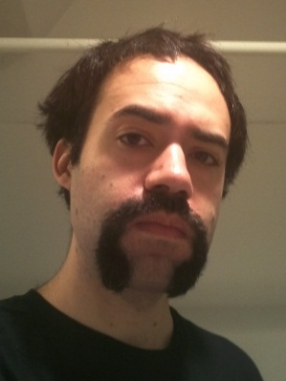
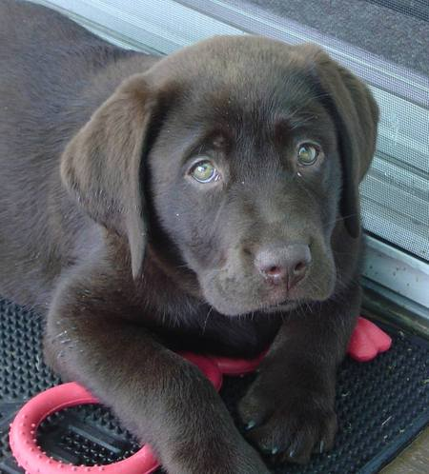
Our Lab
CHOCOLATE Lab
Co PIs
David
Fouhey
Daniel
Maturana
Ruffus
von Woofles
Computational
Holistic
Objective
Cooperative
Oriented
Learning
Artificial
Technology
Experts

Slide 2
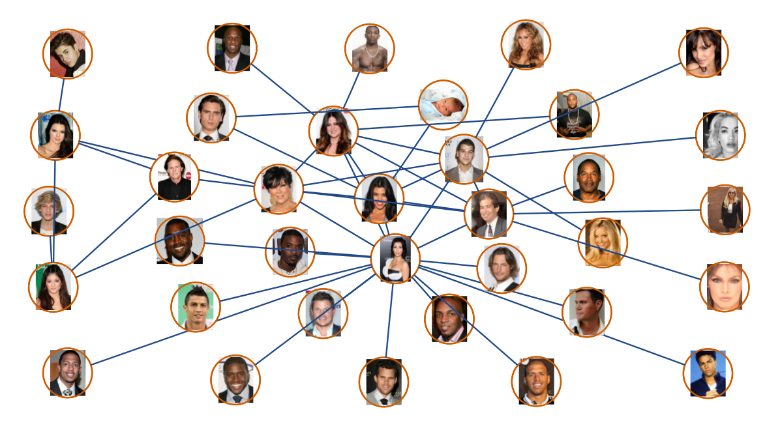
Plug: The Kardashian Kernel (SIGBOVIK 2012)

Slide 3
Plug: The Kardashian Kernel (SIGBOVIK 2012)
Predicted KIMYE March 2012, before anyone else

Slide 4
Plug: The Kardashian Kernel (SIGBOVIK 2012)
Also confirmed KIM is a reproducing kernel!!

Slide 5
Minimum Regret
Online Learning
Daniel Maturana, David Fouhey
CHOCOLATE Lab – CMU RI

Slide 6
Minimum Regret Online Learning
Online framework: Only one pass over the data.

Slide 8
Minimum Regret Online Learning
Online framework: Only one pass over the data.
Also online in that it works for #Instagram #Tumblr #Facebook #Twitter

Slide 9
Minimum Regret Online Learning
Online framework: Only one pass over the data.
Minimum regret: Do as best as we could've possibly done in hindsight

Slide 10
Minimum Regret Online Learning
Online framework: Only one pass over the data.
Minimum regret: Do as best as we could've possibly done in hindsight

Slide 11
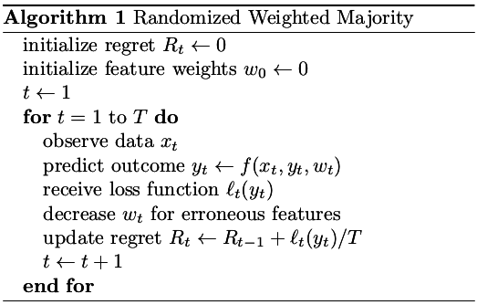
Standard approach: Randomized Weighted Majority (RWM)

Slide 12
Standard approach: Randomized Weighted Majority (RWM)
Regret asymptotically tends to 0

Slide 13
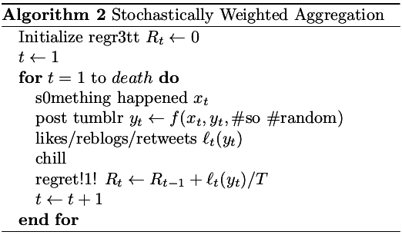
Our approach: Stochastic Weighted Aggregation
Regret asymptotically tends to 0

Slide 15
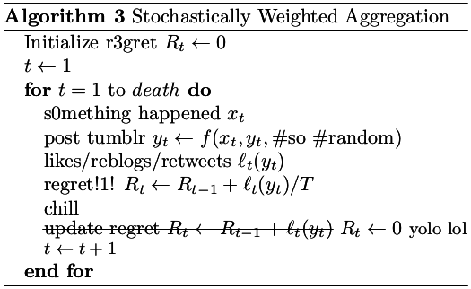
Our approach: Stochastic Weighted Aggregation
Regret is instantaneously 0!!!!

Slide 16
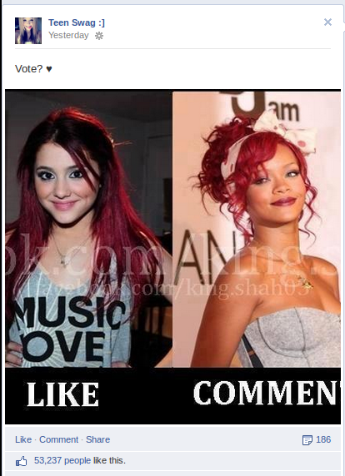
Generalization To Convex Learning
Total Regret = 0
For t = 1, …
Take Action
Compute Loss
Take Subgradient
Convex Reproject
Total Regret += Regret

Slide 17
Generalization To Convex Learning
Total Regret = 0
For t = 1, …
Take Action
Compute Loss
Take Subgradient
Convex Reproject
Total Regret += Regret
SUBGRADIENT
REPROJECT

Slide 18
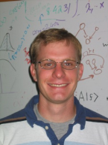
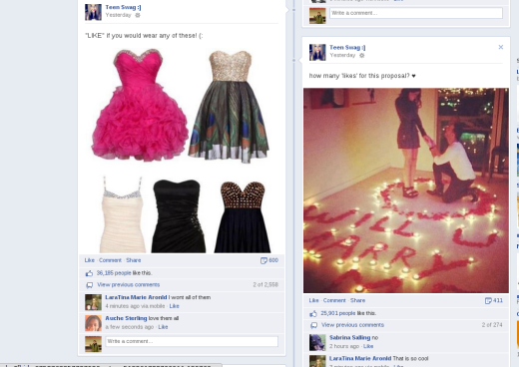
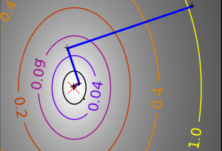
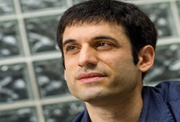
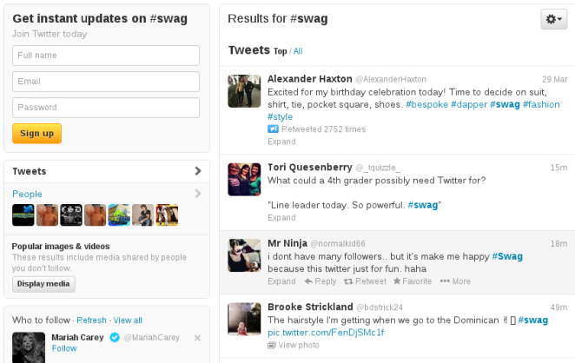
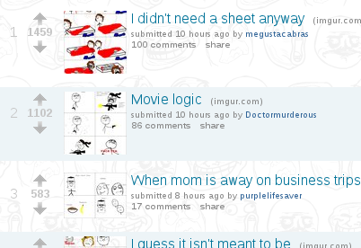
How to Apply? #enlightened
“Real World”
Facebook
Subgradient = Subgradient
Convex Proj. = Convex Proj.
Subgradient = Like
Convex Proj. = Comment
Twitter
Reddit
Subgradient = Retweet
Convex Proj. = Reply
Subgradient = Upvote
Convex Proj. = Comment

Slide 19
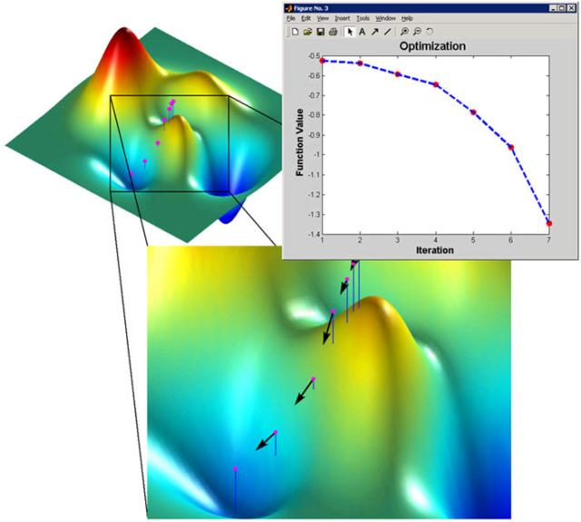
Another approach #swag #QP
Convex Programming – don't need quadratic programming techniques to solve SVM

Slide 20
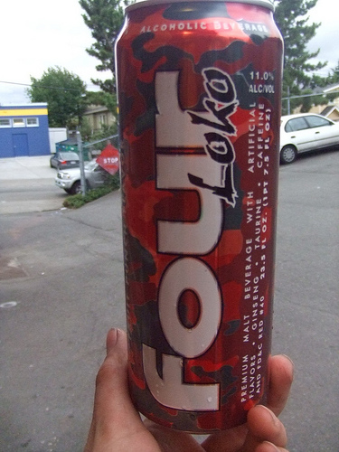
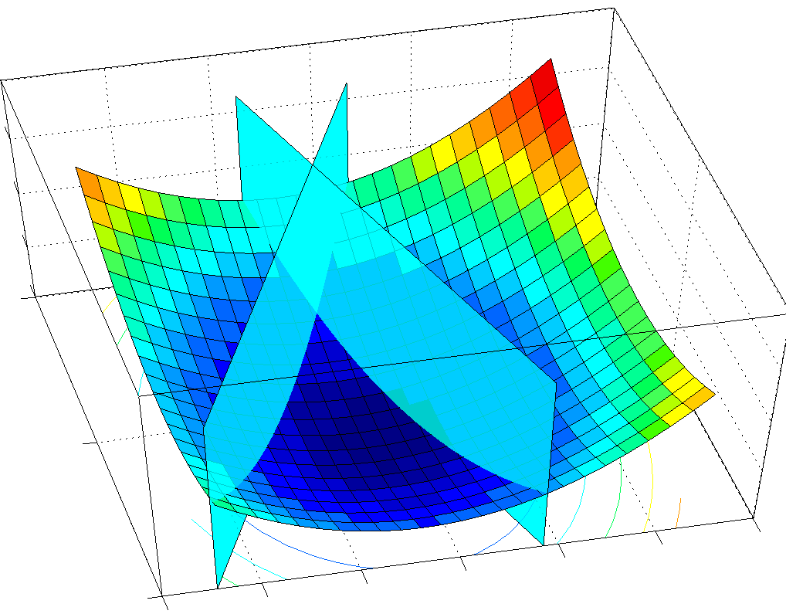
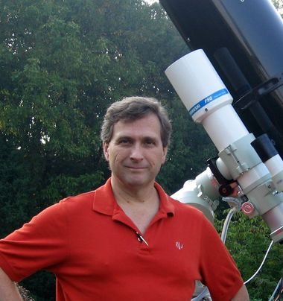
Head-to-Head Comparison SWAG QP Solver vs. QP Solver
4 Loko
LOQO
Phusion et al. '05
Vanderbei et al. '99

Slide 21
A Bayesian Comparison
 | Solves QPs | Refresh-ing | SWAG | # States Banned | % Alcohol | # LOKOs
4 LOKO | NO | YES | YES | 4 | 12 | 4
LOQO | YES | NO | NO | 2 | 0 | 1

Slide 22
A Bayesian Comparison
 | Solves QPs | Refresh-ing | SWAG | # States Banned | % Alcohol | # LOKOs
4 LOKO | NO | YES | YES | 4 | 12 | 4
LOQO | YES | NO | NO | 2 | 0 | 1
Use ~Max-Ent Prior~
All categories
equally
important.
Le Me, A Bayesian

Slide 23
A Bayesian Comparison
 | Solves QPs | Refresh-ing | SWAG | # States Banned | % Alcohol | # LOKOs
4 LOKO | NO | YES | YES | 4 | 12 | 4
LOQO | YES | NO | NO | 2 | 0 | 1
Use ~Max-Ent Prior~
All categories
equally
important.
Le Me, A Bayesian
Winner!

Slide 24
~~thx lol~~
#SWAGSPACE

Slide 25
Before: Minimum Regret Online Learning
Now: Cat Basis Purrsuit

Slide 26
Cat Basis Purrsuit
Daniel Caturana, David Furry
CHOCOLATE Lab, CMU RI

Slide 27
Motivation
Everybody loves cats
Cats cats cats.
Want to maximize recognition and adoration with minimal work.
Meow

Slide 28
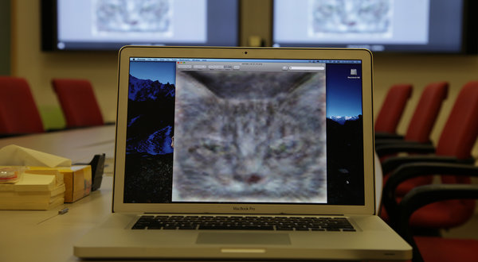
Previous work
Google found cats on Youtube [Le et al. 2011]
Lots of other work on cat detection[Fleuret and Geman 2006, Parkhi et al. 2012].
Simulation of cat brain [Ananthanarayanan et al. 2009]

Slide 29
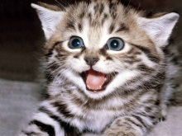
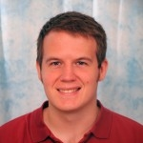
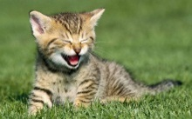
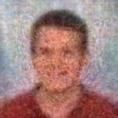
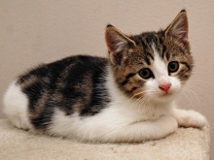
Our Problem
Personalized cat subspace identification: write a person as a linear sum of cats
C^{N}

Slide 30
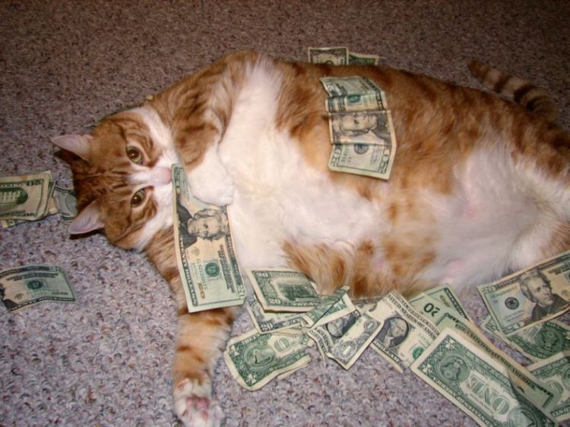
Why?
People love cats. Obvious money maker.

Slide 31
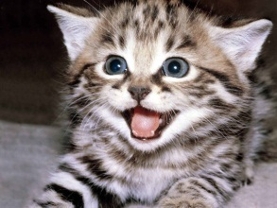
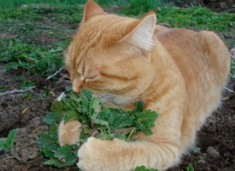
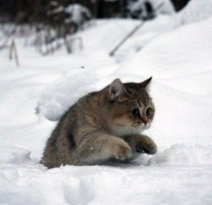
Problem?
Too many cats are lying around doing nothing.
Want a spurrse basis (i.e., a sparse basis)
=4.3
+1.2
+0.8
+…+0.01
=8.3
+0.0
+1.3
+…+0.00

Slide 32
Solving for a Spurrse Basis
Could use orthogonal matching pursuit
Instead use metaheuristic

Slide 33
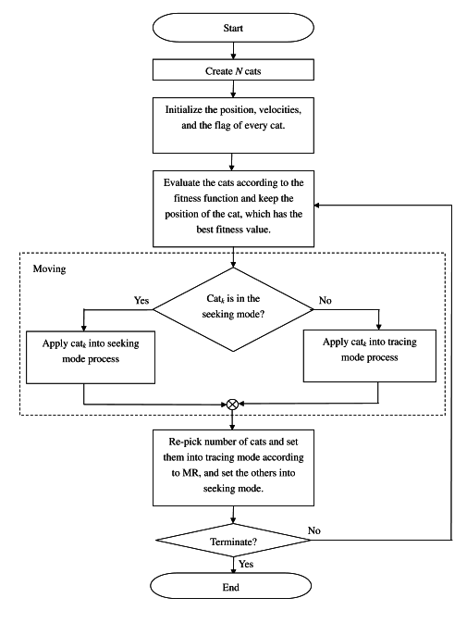
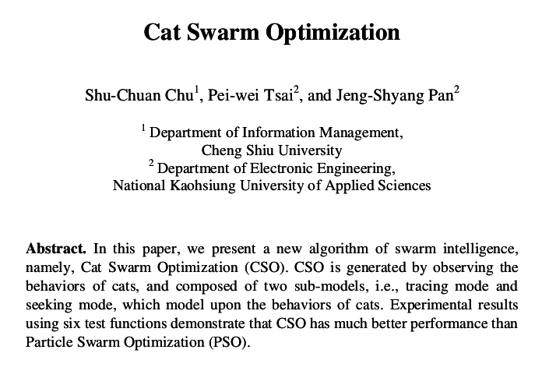
Solution – Cat Swarm Optimization

Slide 34
Cat Swarm Optimization
Motivated by observations of cats
Seeking Mode
(Sleeping and Looking)
Tracing Mode
(Chasing Laser Pointers)

Slide 35
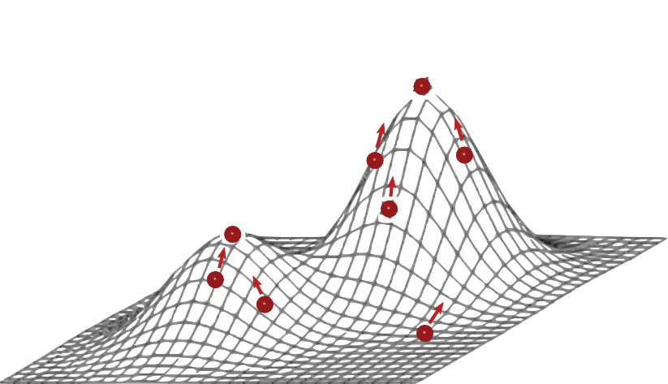
Cat Swarm Optimization
Particle swarm optimization
First sprinkle particles in an n-Dimensional space

Slide 36
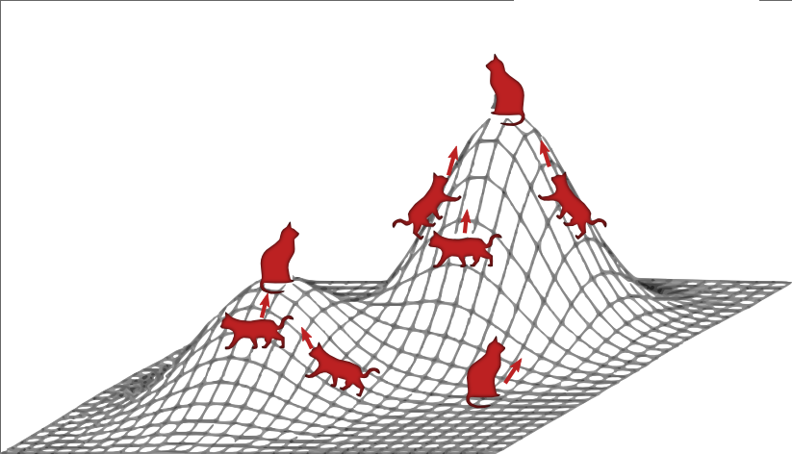
Cat Swarm Optimization
Cat swarm optimization
First sprinkle cats in an n-Dimensional space*
*Check with your IRB first; trans-dimensional feline projection may be illegal or unethical.

Slide 37
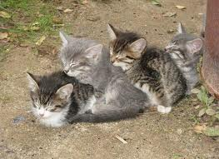
Seeking Mode
Sitting around looking at things
Seeking mode at a local minimum

Slide 38
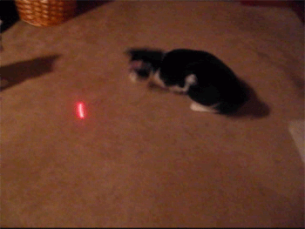
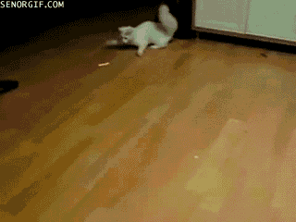
Tracing Mode
Chasing after things
In a region of convergence
Scurrying between minima

Slide 39
Results – Distinguished Leaders

Slide 40
More Results – Great Scientists

Slide 41
Future Work

Slide 42
Future Work
Cat NIPS 2013:
In conjunction with: NIPS 2013
Colocated with: Steel City Kitties 2013

Slide 43
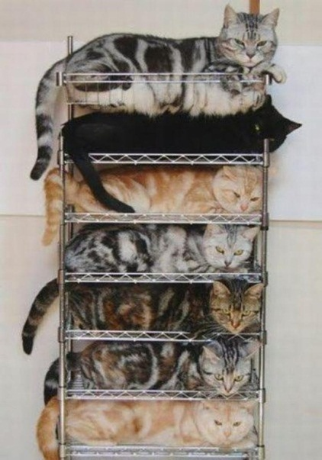
Future Work
Deep Cat Basis

Slide 44
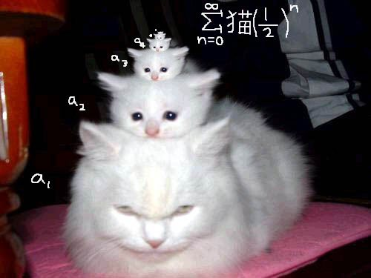
Future Work
Hierarchical Felines

Slide 45
Future Work
Convex Relaxations for Cats

Slide 46
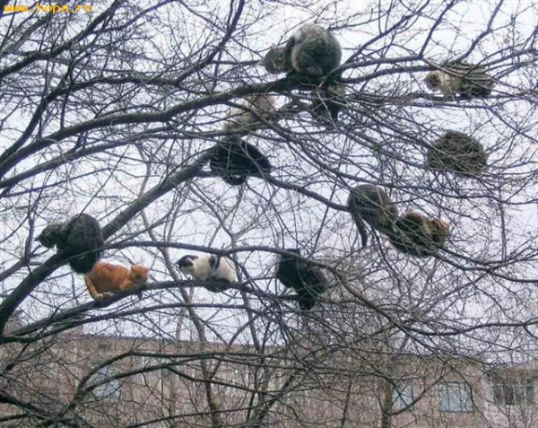
Future Work
Random Furrests

Slide 47
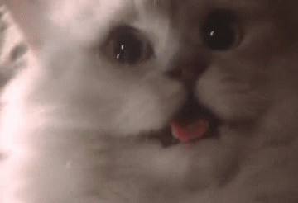
Questions?

